Slide 2

1
8
Lesson 18
Set I-Definition and Subsets

Slide 3
Part 1
Sets and Elements

Slide 4
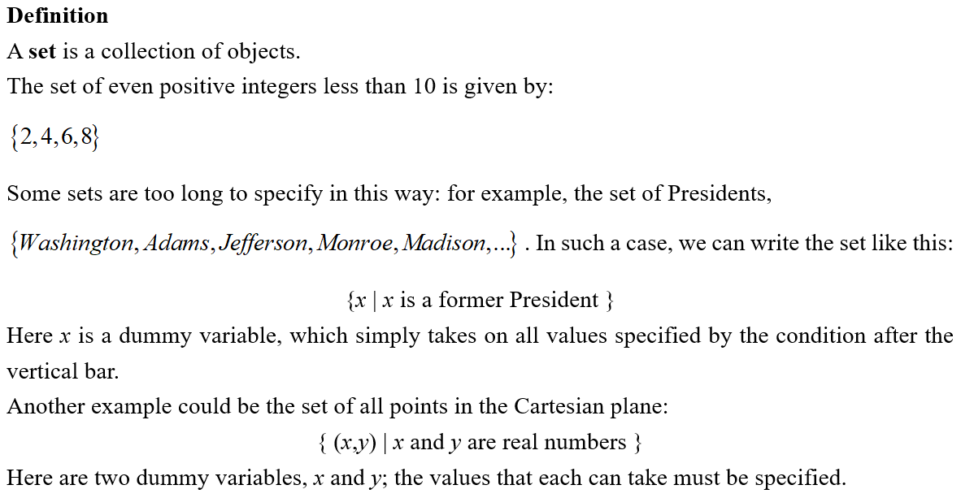
Lead in

Slide 5
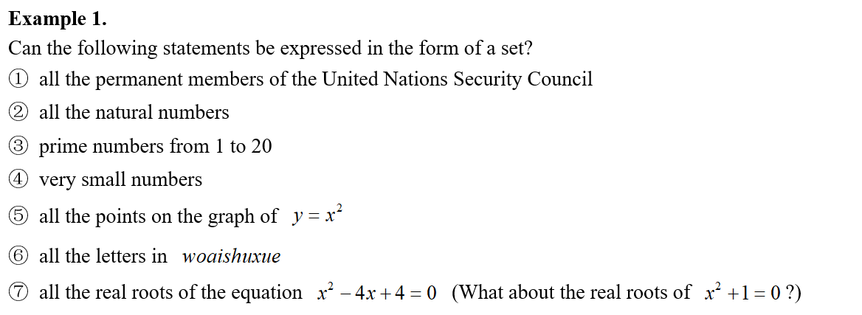

Example

Slide 6

Lead in

Slide 7


Lead in

Slide 8

Example

Slide 9

Example

Slide 10

Example

Slide 11

Example

Slide 12

Example

Slide 13

Example

Slide 14

Example

Slide 15

Lead in

Slide 16

Example

Slide 17
Part 2
Null set and Subset

Slide 18

Lead in

Slide 19
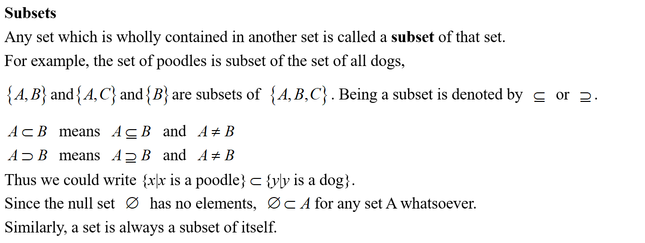
Lead in

Slide 20

Example

Slide 21

Example

Slide 22

Example

Slide 23

Example

Slide 24

Example

Slide 25

Example

Slide 26

Example

Slide 27
See You Next Time!

